Slide 1

FireDrones
by SHC Team
Everyone can be a firefighter and save the world

Slide 2
$12.3B Economic loss
3200+
Deaths
Caused by fires in the year 2015, in the USA alone

Slide 3
Main issues
Satellite latency
Isolated area
Alerts arrive up to 3 hours later
from satellites
Sometimes, no one can send an alert,
or they can’t figure out their location in the wild

Slide 4
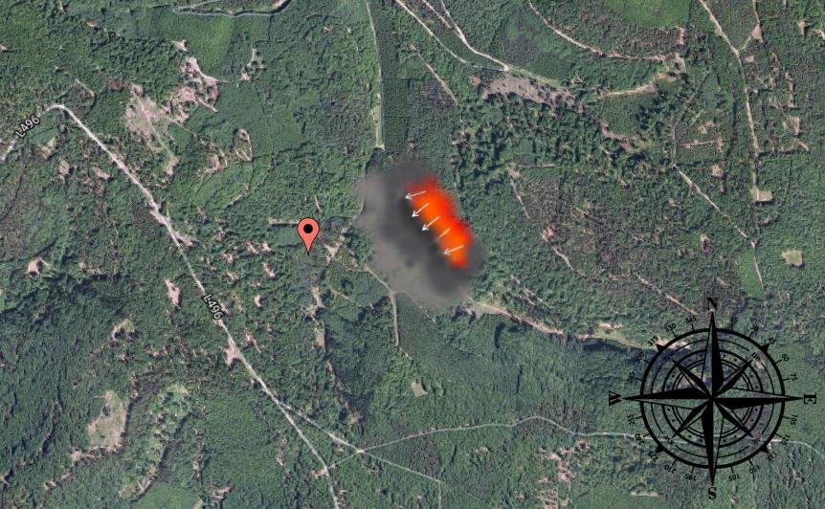
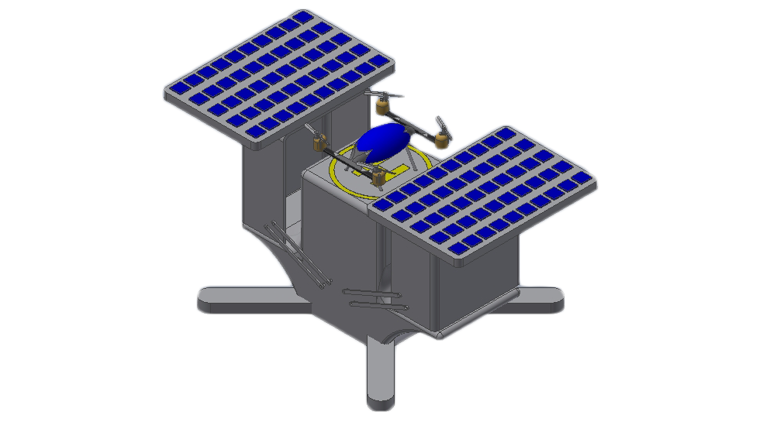
System workflow
App alert
Aerial drones
Fire analysis
An user sends an alert using our app
Autonomous, solar charged drones start to fly over the reported area
Real time imagery from the drones is used to build a fire spreading map
Data insights
Our system launches a scan because some data suggested a wild fire

Slide 5
Insight system
NASA Satellites
Global fire risk map
Weather stations
Data analysis
& interpretation
(machine learning)
Temperature, humidity and wind
Drone trigger
Custom sensors
Deployed based on the scenario
Historical Data
Past events and data

Slide 6


Slide 8
Benefits
Up to
87%
estimated response time
reduction
Quicker fire identification, even without user reports thanks to insights from ambient data
Firefighters will know the situation in advance and arrive prepared, optimizing resources
Users in the area are alerted through the app and given the best way out thanks to the real-time map
Combined with wind data, nearby cities will know in advance the possibilities of ash and smoke

Slide 9
Future vision
Flexible
Thanks to expandable and
simple architecture
The system can be expanded to manage other disasters and situations e.g.:
volcanic eruptions
floodings
landslides
earthquakes (for finding people)
generic surveillance

Slide 10
Thank you for your attention
We hope we demonstrated the possibilities of our idea, and you
can appreciate the amount of effort we put into developing our concept.
Sincerely the SHC Team,
Giacomo De Lazzari
Cristian Marchetto
Damiano Tessaro
Mirco Zenere

